Slide 1
ENG111
Chapter 5: Non-verbal messages
Shahneela Tasmin Sharmi (STS1)

Slide 2


Slide 3

Nonverbal Communication
Nonverbal communication are cues we send with our body, voice, space, time, and appearance to support, modify, contradict, or even replace a verbal message.
We use nonverbal communication to:
Emphasize, substitute or contradict verbal messages.
Repeat, elaborate, or finish a verbal message.

Slide 4
Characteristics of Nonverbal Communication
Nonverbal communication is inevitable i.e.- We cannot NOT communicate
Nonverbal communication is the primary conveyer of emotions. 93% of emotional meaning of messages is conveyed nonverbally.
Nonverbal communication is multi-channeled. Posture, gestures, facial expressions, vocal pitch and rate and appearance.
Nonverbal communication is ambiguous, i.e.-very few nonverbal messages mean the same thing to everyone.

Slide 5
Types of Nonverbal Communication: click here!
1. Use of Body (or Kinesics) includes:
Gestures are the movements of our hands, arms and fingers to accompany or replace a verbal message.
Eye contact can signal a variety of different emotions.
Facial Expression can convey fear, sadness, surprise, anger and disgust through the use of facial muscles.
Posture is how we position and move our body.
Touch refers to spontaneous touch (automatic or subconscious) , ritualized touch (scripted) or task-related touch (perform a job-related function).

Slide 6
Types, Contd.
2. Use of Voice or Paralanguage (Vocalics) is the spoken message that goes beyond the actual words.
Pitch is the highness or lowness of vocal tone.
Volume is the loudness or softness of vocal tone.
Rate is the speed at which a person speaks.
Voice Quality is the sound of a person’s voice that distinguishes it from others.
Intonation is the variety or melody of one’s voice. https://www.youtube.com/watch?v=yUjhSBjxuXA
Vocalized pauses are extraneous sounds or words that interrupt fluent speech. Fillers like ‘umm’, ‘err’ etc.

Slide 7
Types, Contd.
3. Use of Space (or Proxemics) refers to how space and distance communicate.
Personal space is the distance we try to maintain when interacting with others. Intimate distance (up to 18in) for private conversations. Personal distance (18in-4ft) for casual conversation, Social distance (4-12ft) for impersonal business conversations and Public distance (more than 12ft).
Territorial space is the physical space over which we claim ownership. Your room, Office space- personalization.
Acoustic space is the area over which our voice can be comfortably heard.

Slide 8
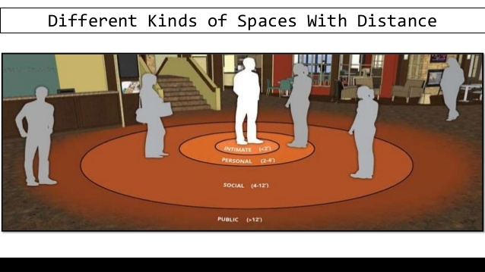
Proxemics- Personal Space

Slide 9
Types, Contd.
4. Use of Time (or Chronemics) is how we interpret the use of time; it is largely based on cultural norms See Chapter 3

Slide 10
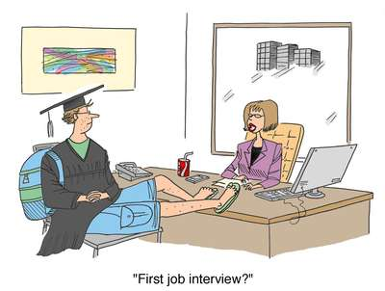
Types, Contd.

Slide 11
Types, Contd.
5. Physical Appearance is how we look to others and is one of the first things others notice and judge e.g. – clothing choices, body art (tattoos), personal grooming, etc.

Slide 12
Media Richness Theory
Media Richness refers to how much and what kinds of information can be transmitted via a particular channel.
Media Richness Theory suggests that some media are better suited than others for communicating the meaning of different types of messages.
Text Message → Email → Phone Conv. → FaceTime →Face-to-face

Slide 13
Sending Nonverbal Messages
When sending nonverbal messages:
Consciously monitor by trying to be more aware of the nonverbal messages you send.
Intentionally align your nonverbal messages with your purpose. When nonverbal messages contradict verbal messages, people are more likely to believe the nonverbal message.
Adapt your nonverbal message to the situation. Try to vary your nonverbal messages according to your context.
Reduce or eliminate distracting nonverbal messages. Tapping your fingers, checking your phone, using lots of pauses, etc.

Slide 14
Interpreting Nonverbal Messages
Remember that the same nonverbal message may mean different things to different people since most nonverbal messages have different meanings.
Consider each nonverbal message in context because any nonverbal message can vary depending on the situation.
Pay attention to the multiple nonverbal messages being sent and their relationship to the verbal messages.
Use perception checking, i.e. – when in doubt ask for clarification for your interpretation.

